Slide 1
Democracy in the USA

Slide 2
Au Pair in America values our Au Pairs as Citizen Ambassadors who bring home to their own countries first-hand knowledge of Americans and our culture.

Slide 3
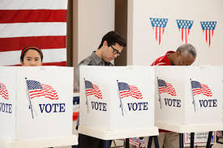
What is a democracy?
It is a form of government in which people choose leaders by voting.
Merriam-Webster Dictionary

Slide 4
What is the US form of democracy?
The two most common types of democracies today are presidential and parliamentary.
The United States has a presidential democracy.

Slide 6
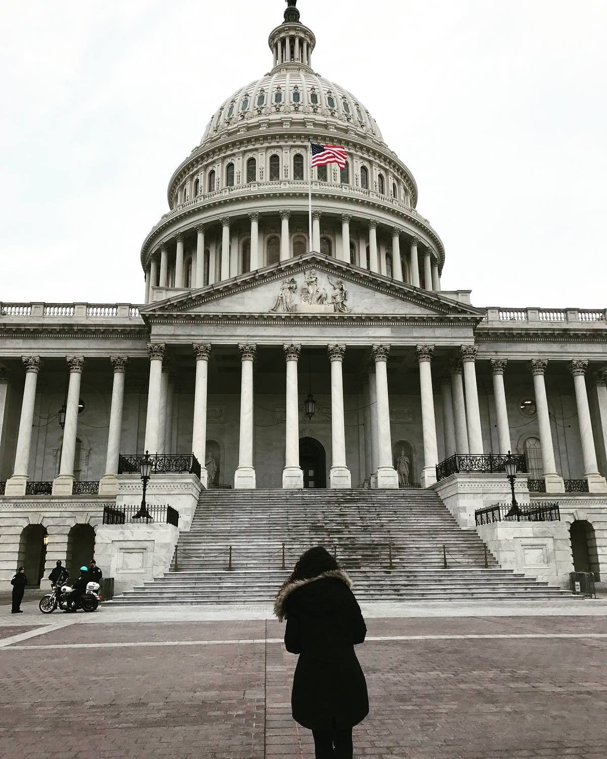
Legislative Branch – US Congress
Congress is divided into two parts: the Senate and the House of Representatives.
Members of Congress write and vote on laws (also called legislation).
Congress creates annual government budget which is paid for by taxing the citizens.
Congress has the power to declare war.

Slide 7
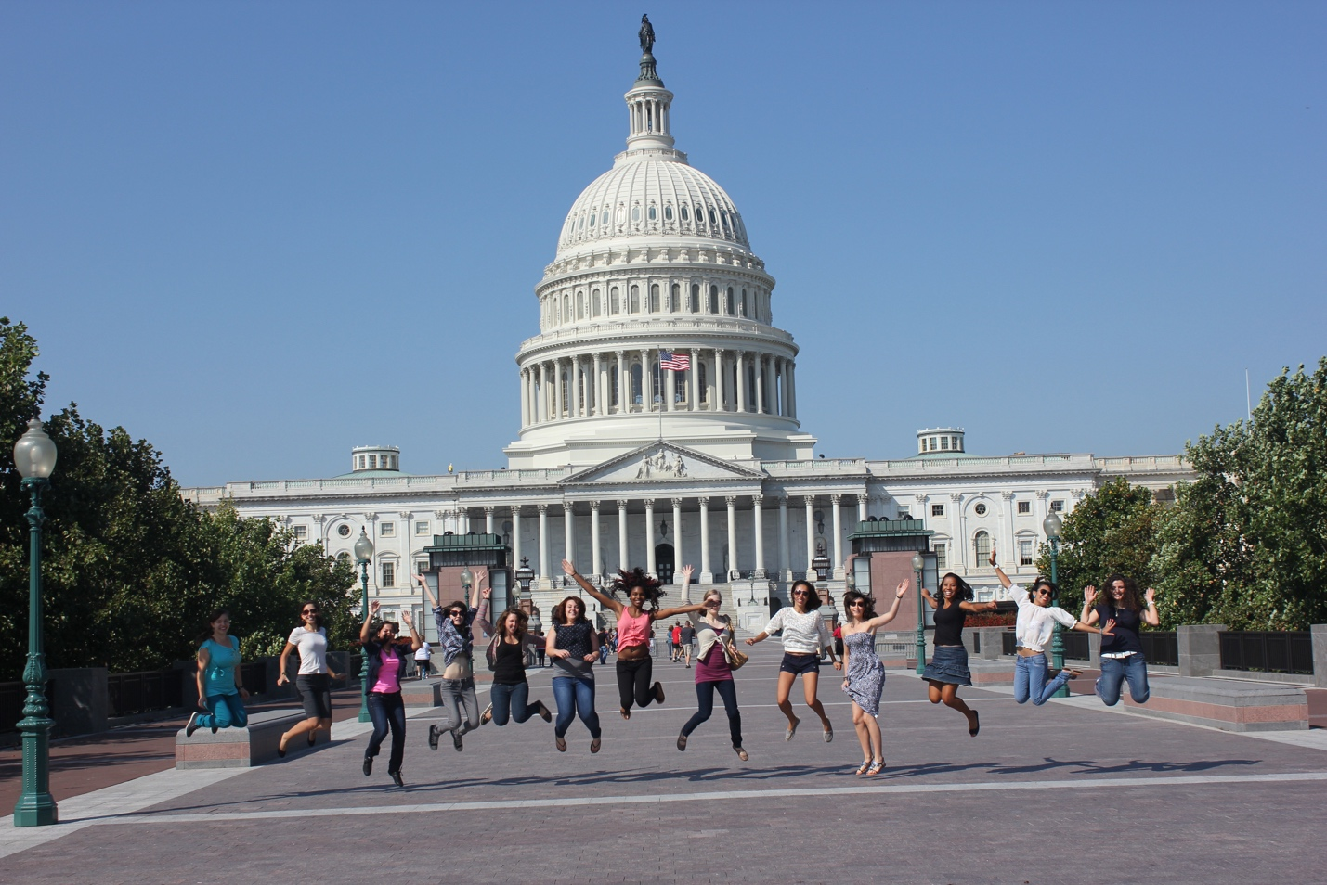
Legislative – The Senate
The Senate has 100 members because each of the 50 states elects two Senators.

Slide 8
Legislative – The House of Representatives
There are 435 total members in the House of Representatives.
Each state has a different number of representatives depending on its total population. States with more people get more representatives.

Slide 9
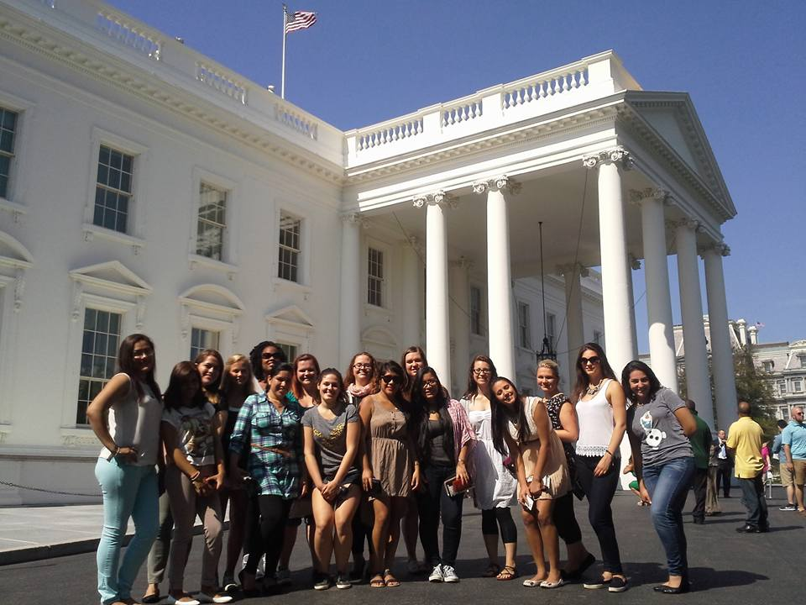
Executive Branch – The President
The President is the head of the Executive Branch.
He or she is elected every four years and can only serve two terms.
The President lives and works in the White House in Washington, DC.

Slide 10
Executive- Vice President and Cabinet
The Executive Branch includes the Vice President
He or she belongs to the same political party as the President and is elected along with the President
Always ready to assume the role of President if necessary
Also serves as President of the US Senate and can cast a tie-breaking vote in the Senate
The Executive Branch also includes the Cabinet
Cabinet Members are appointed by the President and confirmed by the Senate
Run the key departments of government and advise the President

Slide 11
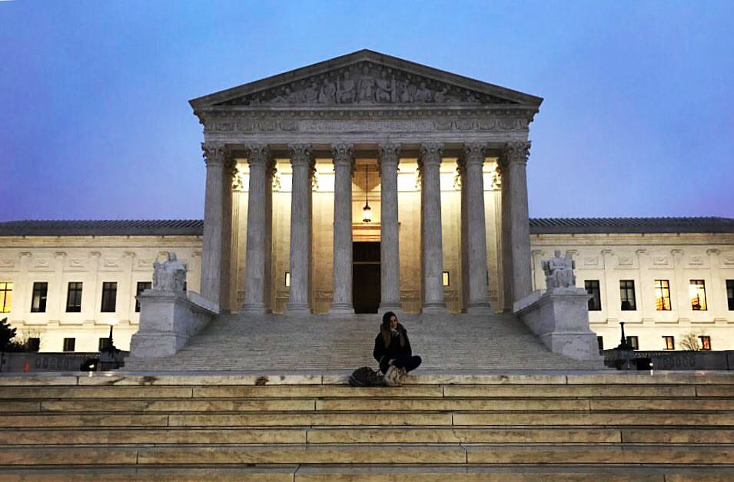
The Judicial Branch
The Supreme Court heads the Judicial Branch of the United States government.
Supreme Court Justices are appointed by the President, confirmed by the Senate, and serve for a lifetime.
There are nine Justices on the modern Supreme Court.
The Supreme Court is the only court established by the US Constitution.
The decisions they make are of national importance and are absolute and final.

Slide 12
Three-Ring Government

Slide 13
US Presidential Elections
November: Election Day
Every 4 years
December: Electoral College
Voters in general election actually chose electors
January: Inauguration Day
The President and the Vice President are sworn into office on January 20th
The first Tuesday after November 1st
Electors vote in December
Happens every 4 years

Slide 14
The Electoral College

Slide 15
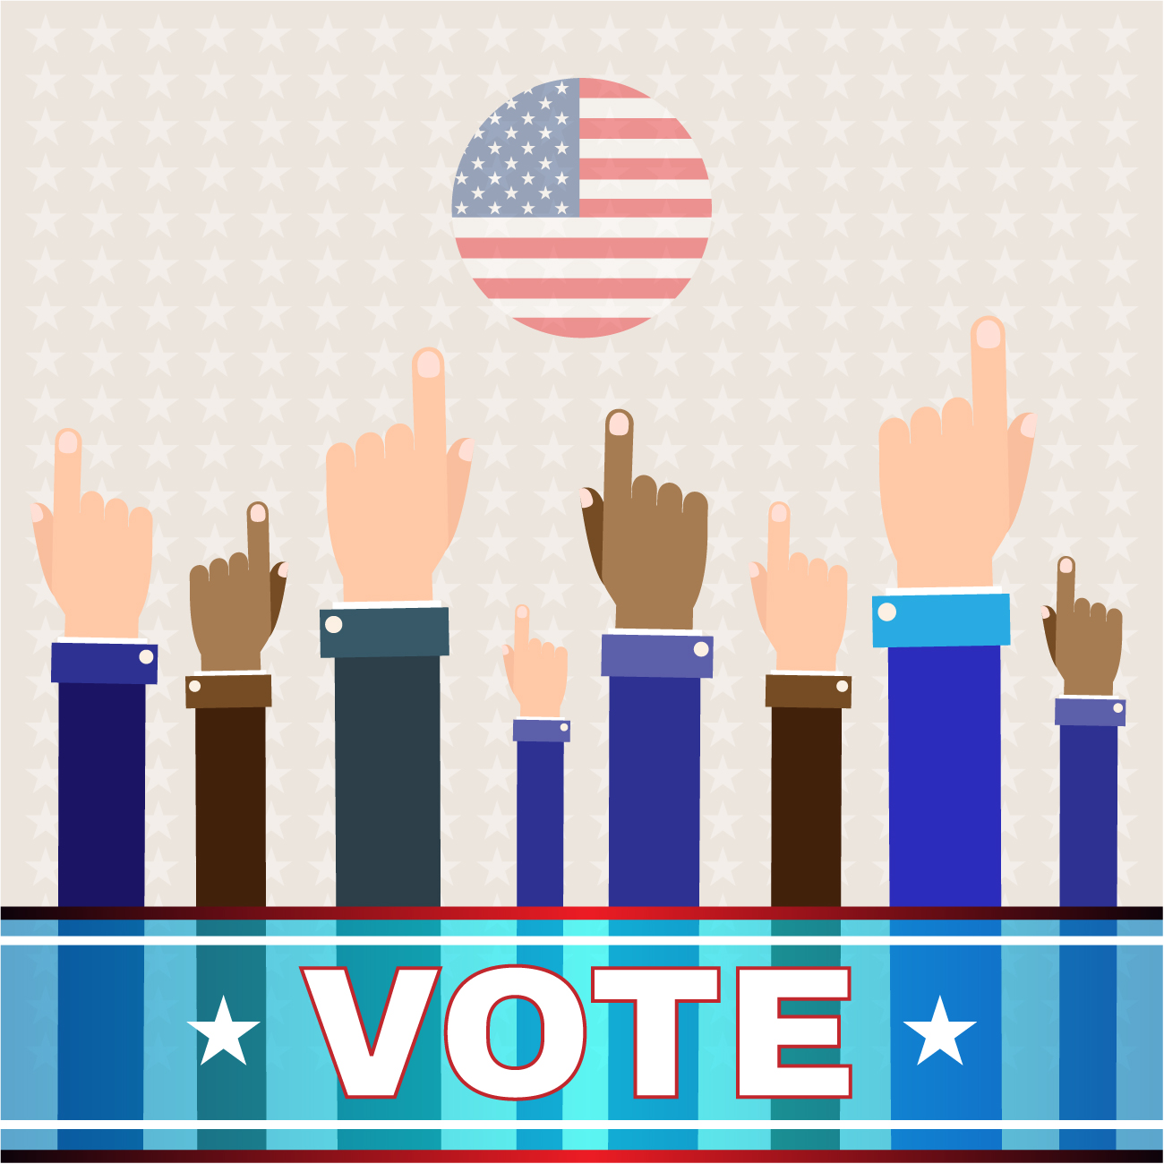
The US Election Cycle
US Representatives are elected every two years with no term limits.
Senators are elected every six years with no term limits.
The President is elected every four years and can only serve two terms (eight years).
www.Freepik.com

Slide 16
Learn More About the US Government
Visit your local city, county or state government buildings. They often have open hours and opportunities for you to visit many of these beautiful buildings.
Visit Washington, DC. From the many museums and monuments to tours of the US Capitol, there is so much to see and do in DC!
Your Community Counselor can direct you to places to visit, classes about US government, and travel ideas.

Slide 17
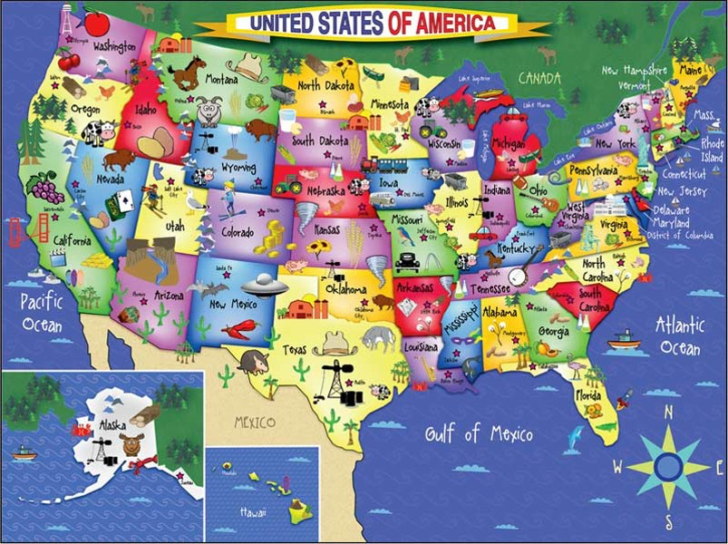
Explore the USA!
Au Pair in America encourages all of you to explore the USA during your au pair year.
Use your free weekends, vacations and travel month to visit the places here you really want to see. Don't waste your money on things, rather spend it on experiences! Have fun and be adventurous!

Slide 18
Are You a Fearless Global Citizen?
A Fearless Global Citizen
Steps outside their comfort zone—leaving behind the familiar, unafraid to travel to learn more about themselves and the world.
Experiences a variety of cultures firsthand—learning about the world, its people and its cultures through travel simply has no substitute.
Explores the world to enhance their career: gaining an international perspective creates a broader understanding and respect of ideas and commerce around the world.
Gains appreciation of the world around them—respecting fellow global citizens begins with the understanding of their lives, culture and values, which results in genuine appreciation.
Embraces diversity—whether it's religion, race, culture or gender, diversity comes in many forms. In order to learn from one another, we must first gain an understanding about one another.
www.fearlessglobalcitizen.org

