Slide 1
GLOBAL AWARENESS 101

Slide 2
What is Global Awareness?
Global Awareness is a unique volunteer program offered by Au Pair In America.
Its mission is to promote multi-cultural understanding and to build cross-cultural bridges.
The goal of the program is to encourage better understanding of other cultures, to improve communication between cultures, and to support the concept of mutual acceptance.

Slide 3
Benefits of Global Awareness for Au Pairs:
Be part of a global community and learn from each other
Practice public speaking in front of a small group and gain self confidence
Be able to volunteer on a regular basis and obtain letters of recommendation
Add this experience to your resume
Earn a Certificate of Recognition
Earn incentives for participation in contests organized by Global Awareness or for doing presentations in your community
.

Slide 4
What Au Pairs are saying about Global Awareness?
Jurisa, South Africa- it allowed me to learn new things about my country and culture.
Marion, the Netherland- I was able to volunteer on a regular basis and was able to find a job back home thanks to the letters of recommendation I received from the teachers.
Luisa, Mexico-talking in front of a group of people gave me more confidence. I truly enjoyed sharing about my culture and it made me feel even more proud about where I come from.

Slide 5
How do I start?????
Go to www.globalawareness.com

Slide 6
Culture Clash and Blog Topics
Are American children the boss?
Stereotypes
Observation of newly arrived au pairs
Au Pairs helping each other
Hula Dancing In Hawaii
Going to a rodeo in Texas
Au Pairs experience voting in the US
Au Pairs presenting in schools
And more…..

Slide 7
Global Awareness
Contests
Volunteer
Cluster meeting
Presentation

Slide 8
Global Awareness Contests

Slide 9
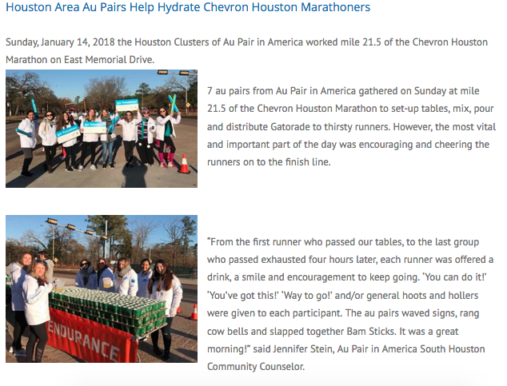
Volunteer

Slide 10
Cluster meeting
Cluster meetings are a great way to share global awareness and bridge cultural divides

Slide 11
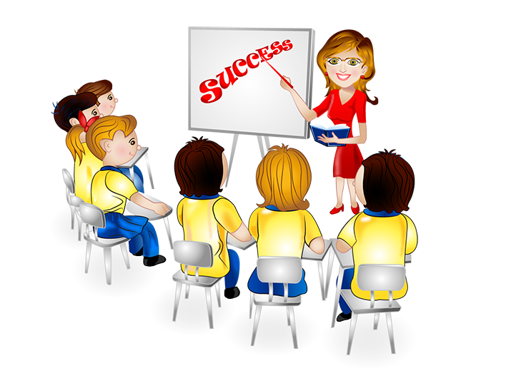
Presentations
SCHOOL/COMMUNITY PRESENTATION OPPORTUNITIES

Slide 12
1. Pick a venue in your community where you can talk about Global Awareness topics:
SCHOOL or PRESCHOOL
LIBRARY
SCOUT GROUP
COMMUNITY CENTER
INTERNATIONAL FAIR
BIRTHDAY PARTY
PLAY GROUP
SCHOOL
LIBRARY
SCOUT TROUP
COMMUNITY CENTER
INTERNATIONAL FAIR
BIRTHDAY PARTY
PLAY GROUPS

Slide 13
2. Introduce yourself to the teacher or group leader and offer to become a guest speaker.

Slide 14
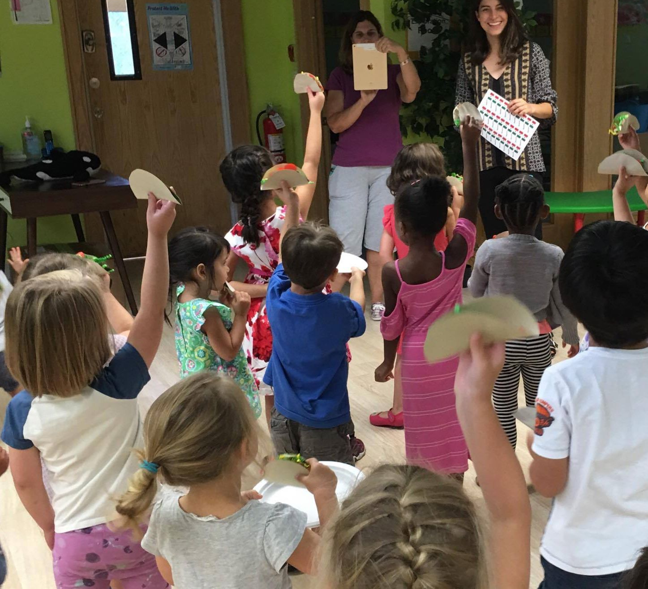
3. Schedule a date to visit a classroom or group of your choice.

Slide 15
4.Go to www.GlobalAwareness.com and click on: “Get Involved”.

Slide 16
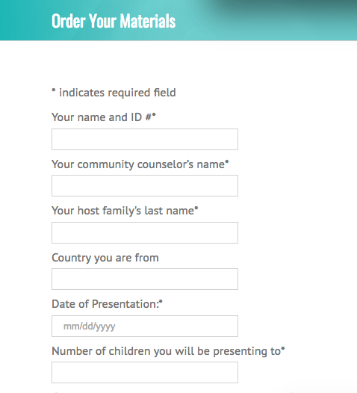
5.Fill out the online form titled “Order Your Materials”.

Slide 17
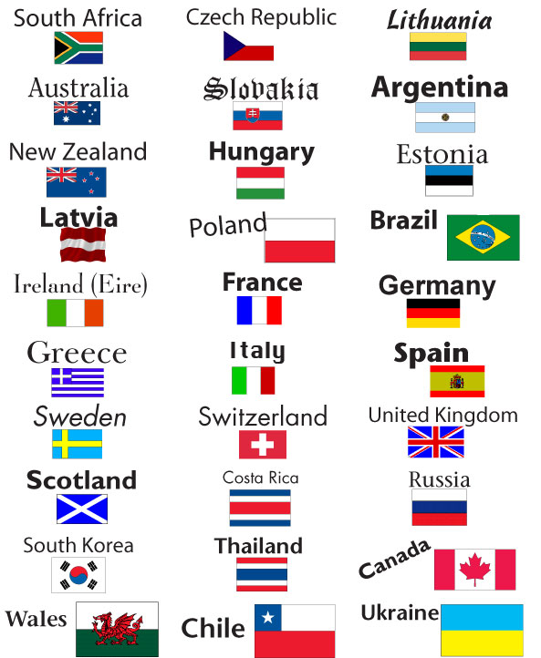
SAMPLE MATERIAL
Country Flag Stickers
Global Awareness Globe Coloring Pages
GA Country Specific Leave-Behind Flyers
Travel Journals
Student & Parent Activity Sheets
Flag Coloring Pages
Global Awareness Bookmarks

Slide 18
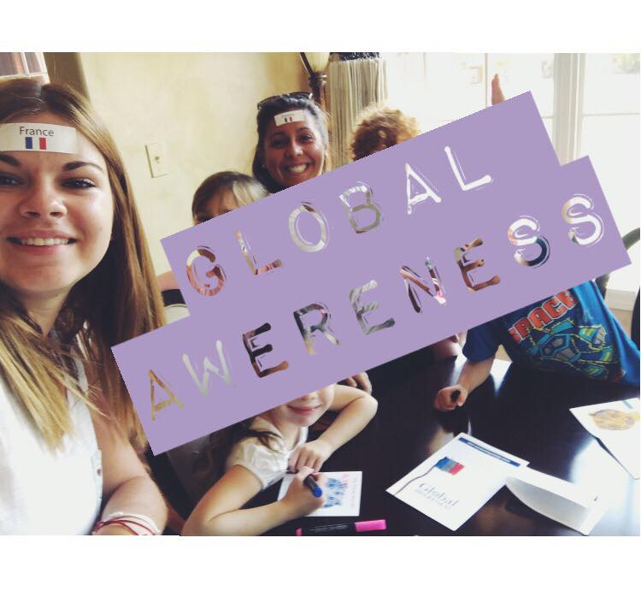
Notes:
On the day of your presentation, be relaxed and enthusiastic about what you’ll present. The kids will love it and have tons of questions. Ask if someone can take pictures.

Slide 19
TOPICS OR IDEAS TO PRESENT

Slide 20
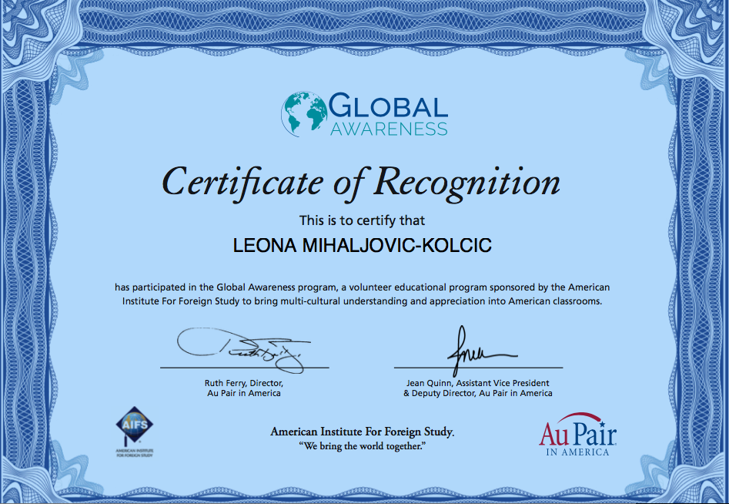
INCENTIVES
Once the presentation is done, email us at globalawareness@aifs.com and you’ll receive a Certificate of Recognition. Ask your Community Counselor if you can share your presentation at a cluster meeting.

Slide 21
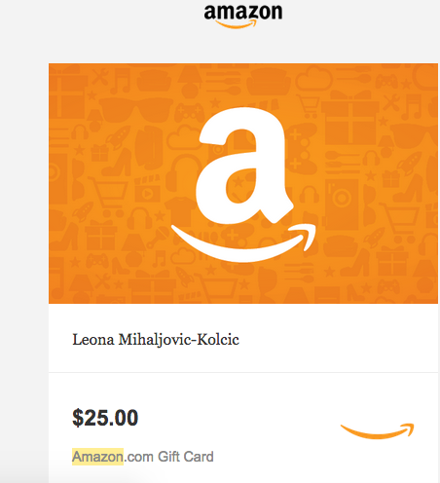
You will also have the opportunity to earn a press incentive by giving us some information about your experience.

Slide 22
For additional information about Global Awareness or other presentations done by Au Pairs, visit us at
www.globalawareness.com

